Slide 1

< 2022/07/07 >
Scaling Up Visual and Vision-Language Representation Learning With Noisy Text Supervision
Yewon Kim

Slide 2
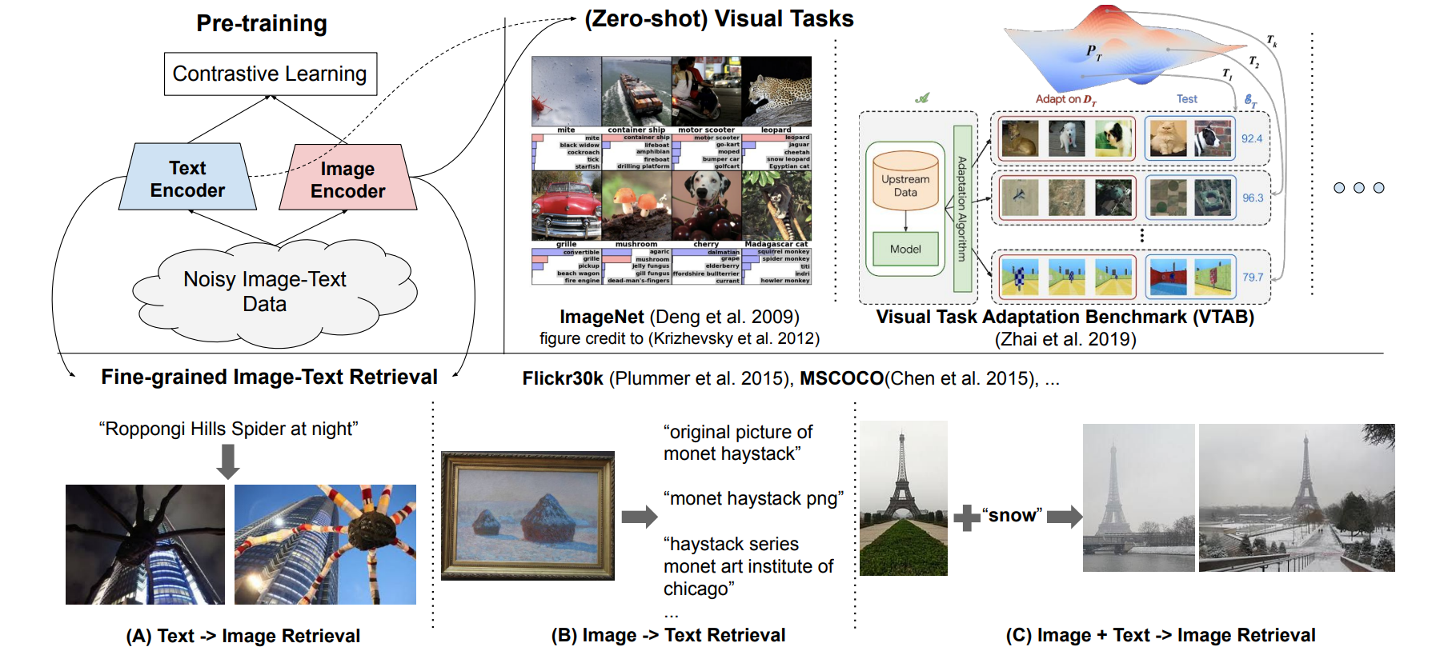
Overview
ALIGN : A Large-scale ImaGe & Noisy Text Embedding
Leverage large-scale noisy image-text data to scale up visual and vision-language representation learning
Avoids heavy work on data curation and annotation, and only requires minimal frequency-based cleaning.
Dual-encoder model with contrastive loss and good calibration

Slide 3
Motivation
Emergence of Large scale model
Curating clean dataset is so expensive!
Reducing burden of preprocessing is needed
Then…….How?
Use dual encoder and learn alignment between image and text pairs with contrastive loss
Google AI Blog: Pathways Language Model (PaLM): Scaling to 540 Billion Parameters for Breakthrough Performance (googleblog.com),
Exploring the Limits of Transfer Learning with a Unified Text-to-Text Transformer
Notes:
ce(classifier-free guidance)가 더 높은 퀄리티의 이미지를 산출한다는 것을 발견합니다.

Slide 4
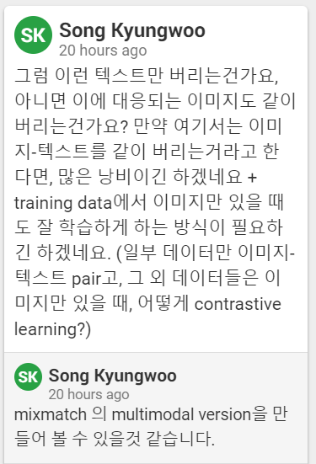
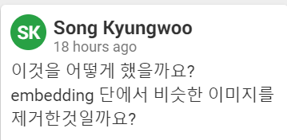
Data Filtering
Image-based filtering
remove pornographic images
keep only images whose shorter dimension is
larger than 200 pixels aspect ratio is smaller than 3
remove duplicates or near-duplicates of test images in all downstream evaluation datasets (embedding cosine similarity is larger than 0.975)
Text-based filtering
exclude alt-texts that are shared by more than 10 images
discard alt-texts that contain rare token
remove too short (<3 unigrams) or too long (>20 unigrams)
ex) “image tid 25&id mggqpuweqdpd&cache 0&lan code 0”

Slide 5
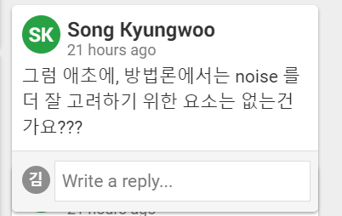

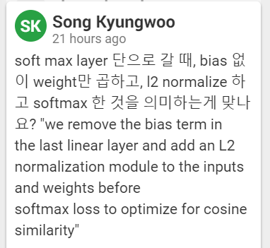

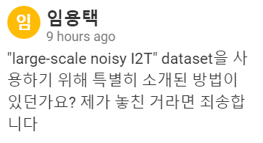
Pre-training on Noisy Image-Text Pairs
Image encoder: EfficientNet
Text encoder: BERT-cls tocken embedding+fc layer
optimized via normalized softmax loss
loss term:
The temperature is learned together
Notes:
사실상 노이즈에 집중한 논문은 아닌것 같다 calibration을 잘해서 noisy한 대형 데이터셋으로 학습했을때 성능이 잘나오게하는게 주목적
걍 calibration이 중요함

Slide 6
Evaluation
Image-Text Task
downstream task: Image-to-text retrieval, text-to-image retrieval
zeroshot
Flickr30K, MSCOCO
Crisscrossed Captions (CxC)
downstream task: l human semantic similarity judgments
image-to-text, text-toimage, text-to-text, and image-to-image retrieval
semantic textual similarity (STS), semantic image similarity (SIS), and semantic image-text similarity (SITS)
MSCOCO fine-tuned ALIGN

Slide 7
Evaluation
Image Classification Task
downstream task: ImageNet ILSVRC-2012 benchmark
ImageNet-R and ImageNet-A are sampled from drastically different distributions from ImageNet
finetune only top classification layer only
fully fine-tuned
Oxford Flowers-102
Oxford-IIIT Pets
Food101
Visual Task Adaptation Benchmark (VTAB)
consists of 19 diverse (covering subgroups of natural, specialized and structured image classification tasks) visual classification tasks with 1000 training samples each.

Slide 8
Experiments and Results
Settings
Image encoder
input images : 346 × 346 resolution
final resolution : 289 × 289 pixels
training: random crop
evaluation: central crop
Text encder
wordpiece sequence of max 64 token
LAMB optimizer with weight decay ratio 1e-5
learning rate :1e-3 from zero in 10k steps, and then linearly decay to zero in 1.2M steps
1024 Cloud TPUv3 cores with 16 positive pairs on each core.
total effective batch size is 16384.
By concatenate embeddings from all computing cores

Slide 9
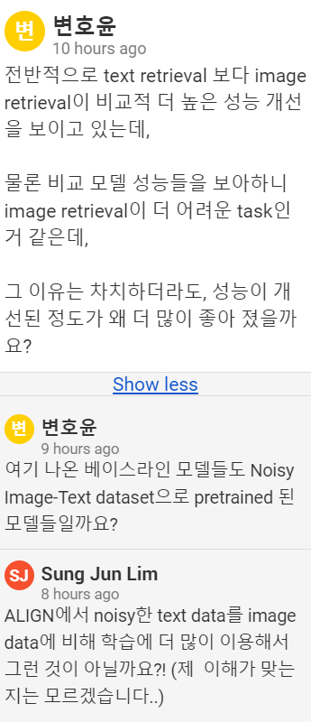
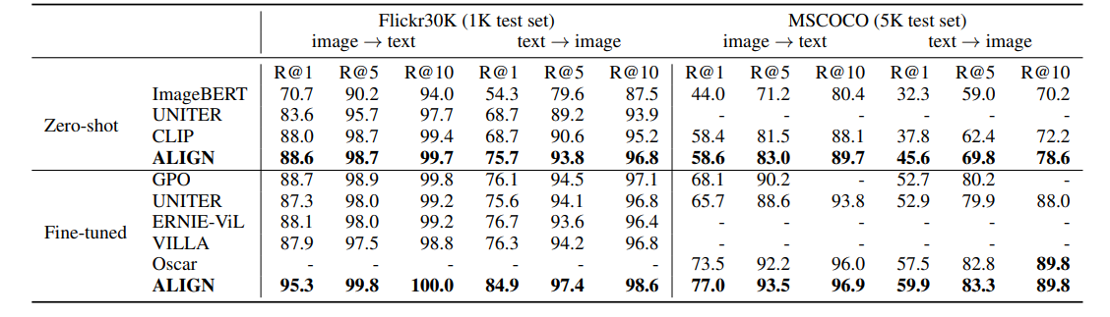
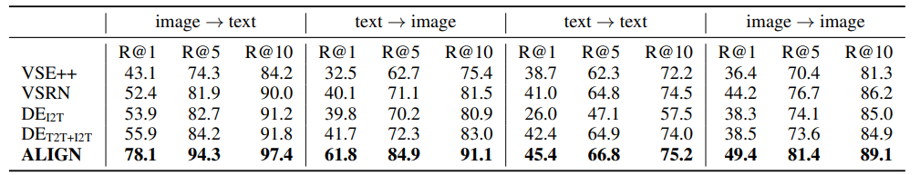
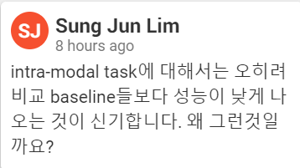
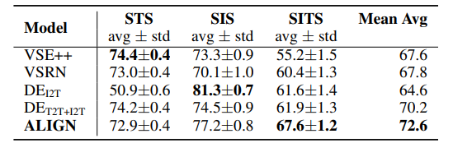
Image-Text Matching & Retrieval
Image-text retrieval
Mutimodal retrieval
ALIGN is not very good at intra-modal tasks
Notes:
성준님과 비슷하게 생각함, 보통 align이 잘되면 intra 성능이 좋아지는것을 기대하는데 아마 noisy한 image text pair가 align되면서 noisy한 텍스트가 그냥 텍스트와 align된다면 그건 그거대로 intra성능이 좋지는 않을듯?

Slide 10
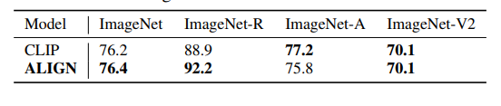
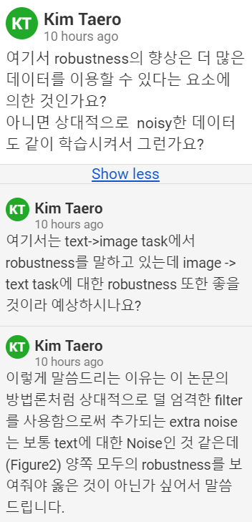
Zero-shot Visual Classification
shows great robustness on classification tasks with different image distributions
Use same prompt ensembling with CLIP

Slide 11
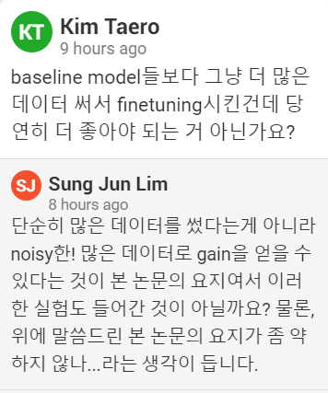
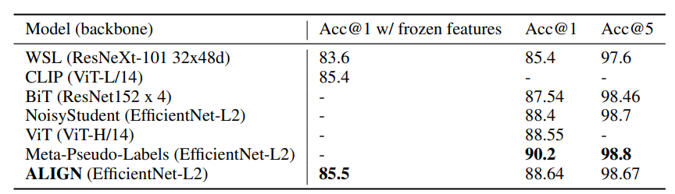
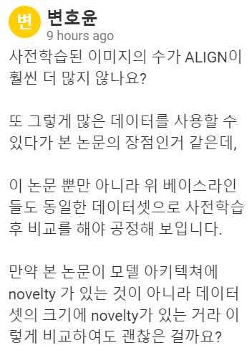
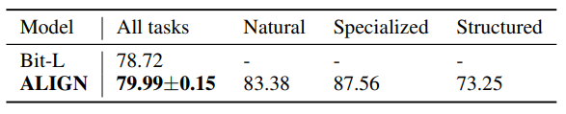
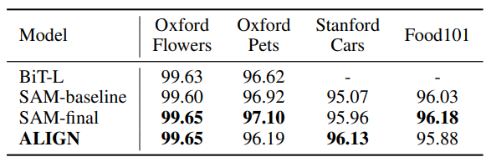
Visual Classification w/ Image Encoder Only
Image classification
EfficientNet-L2, ALIGN saves 44% FLOPS by using smaller test resolution
VTAB(19 tasks)
d
Transfer learning results(fine-grained)
Notes:
Noisy한 데이터가 핵심이라서 가능한것같다 비교를 하는게 우린 노이지한 데이터로 학습시켜도 이만큼 성능나온다!!
너네처럼 굳이 레이블링 할필요ㄴㄴㄴ를 강조하려고 이렇게 결과를 보여준듯
without using SAM optimization for a fairer comparison.

Slide 12
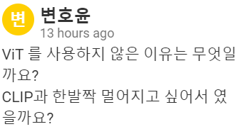
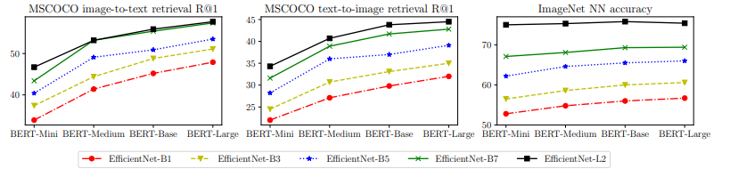
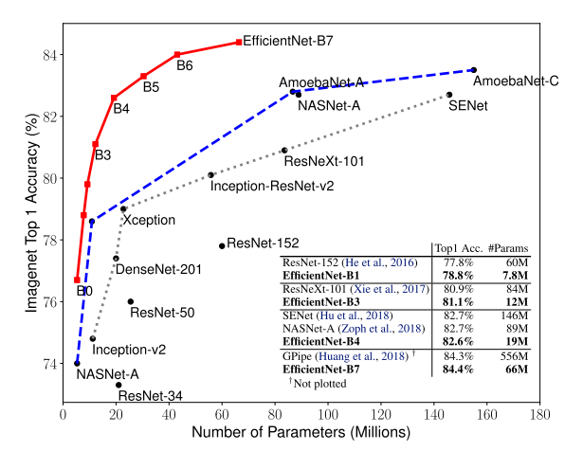
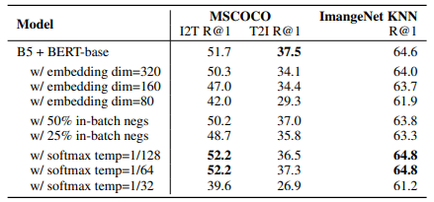
Ablation Study
Model Architectures
size
key architecture parameters →
Notes:
FLOP때문에?? 워낙 큰데이터를 다루는 데 efficientnet의 경우 가장큰 conv network이면서 FLOP을 고려하면서 학습함, 그리고 B1 , L2 는 ViT보다 적어서 인듯
그래서 아쉬운점 모델 아키텍쳐간 ablation study가 없는 아쉬움
temperature가 중요하고 ㅁㅔ뉴얼이 좋긴한데 학습 편하게하려면 학습 파라미터로 두는게 좋음
temperature usually quickly decrease to only around 1.2x of the converged values in the first 100k steps, and then slowly converges
until the end of training.

Slide 13
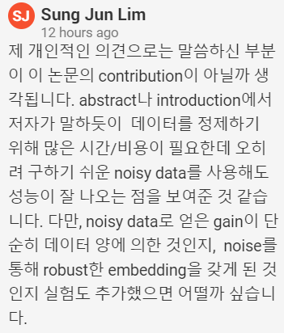
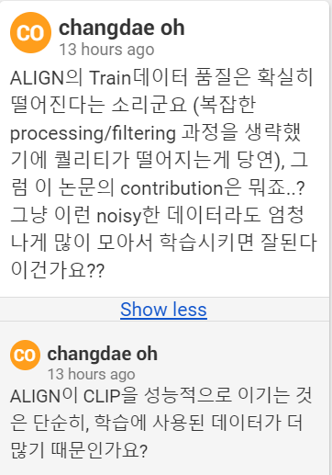
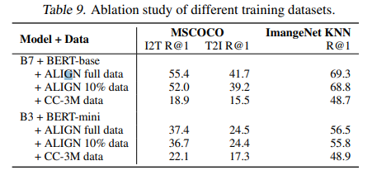
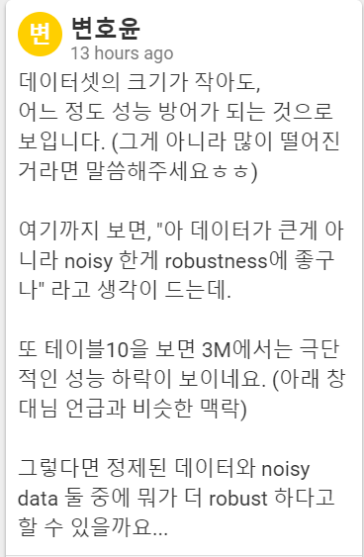
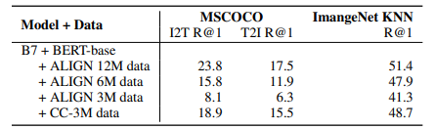
Ablation study
Pretraining dataset
training datasets size
Tradeoff between training data size and quality
data size scaling wins over the increased noise
Notes:
총 데이터수가 1.8B개, 10%라고 해도 적지않은 데이터일듯

Slide 14
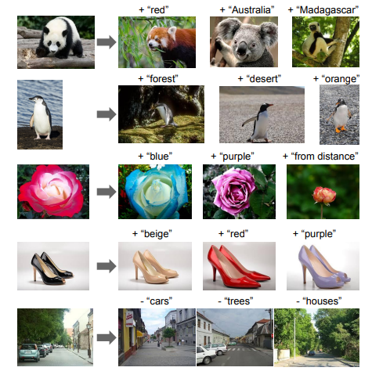
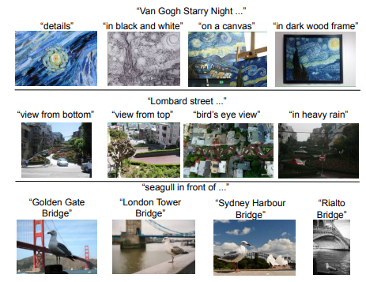
Analysis
ALIGN
demonstrate great compositionality across vision and language domains, show the feasibility of a new paradigm of “search with multi-modal query”
https://dreamgonfly.github.io/blog/gan-explained/

Slide 15
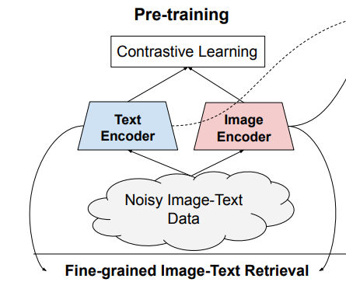
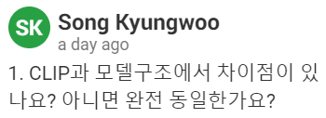
ALIGN vs CLIP
ALIGN
Data curation
large enough to deal with noise
simple data preprocessing
1.8B
contrastive learning
encoder
image : Efficientnet
text: BERT
CLIP
Data curation
WebImageText(0.5B)
search for (image, text) pairs as part of the construction process whose text includes one of a set of 500,000 queries
all words occurring at least 100 times in the English version of Wikipedia
have to construct high -frequency visual concept
contrastive learning
ADAM optimizer
encoder
image : ViT
text: transformer
https://dreamgonfly.github.io/blog/gan-explained/

Slide 16
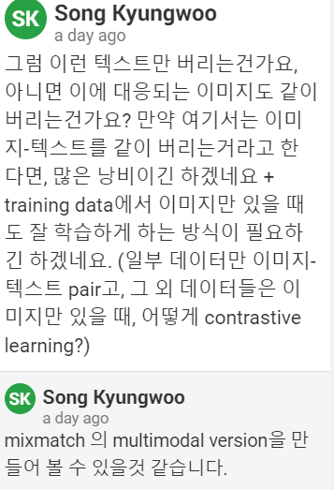
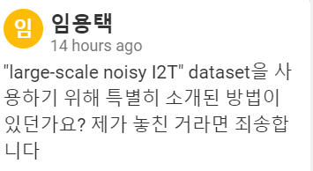
Conclusion & Discussion
Avoids heavy work on data curation and annotation
leveraging large-scale noisy image-text data to scale up visual and vision-language representation learning.
Outstanding result at image-text retrieval
large enough to deal with noise
But, need lot of computational loss
https://arxiv.org/pdf/2206.06522.pdf

